Slide 1


Rodolpho AKAKPO
05/18/2024

Slide 2

Outline
Executive Summary
Introduction
Methodology
Results
Conclusion
Appendix

Slide 3
Executive Summary
The methodology used involved several key steps : first, we thoroughly understood the problem of predicting the successful landing of the Falcon 9 first stage to estimate launch costs. We then collected a comprehensive dataset using SpaceX's API and web scraping techniques. The data collected underwent an understanding stage (exploratory data analysis) where visualization, descriptive statistics helped us understand the relationships between several features and feature engineering helped us in selecting relevant features for our analysis. Moving to a preparation stage the data has been cleaned, preprocessed to ensure quality and usability. We developed and tested multiple machine learning models, including logistic regression, decision trees, support vector machines with cross-validation techniques employed to prevent overfitting. The models were evaluated using different metrics.
The decision tree model emerged as the best performer, providing reliable predictions of landing success.

Slide 4
Introduction
In the competitive landscape of aerospace industry, the ability to reduce launch costs is a significant advantage. SpaceX has revolutionized this domain by successfully reusing the first stage of its Falcon 9 rockets, bringing down the cost of launches to 62 million dollars compared to the industry standard of 165 million dollars. This cost-effectiveness is primarily due to the successful landing and reuse of the first stage, a critical component of their operational model.
The focus of this project is to predict the likelihood of a Falcon 9 first stage landing successfully. Accurate predictions can provide essential insights into launch costs, aiding alternative companies in crafting competitive bids against SpaceX. By leveraging data science techniques, this project aims to understand the factors influencing landing success and develop predictive models to forecast this outcome reliably.

Slide 5

Section 1

Slide 6
Methodology
Executive Summary
Data collection methodology:
Data was collected using SpaceX API and web scraping techniques with python's beautifulsoup, requests modules an pandas library.
Data wrangling
Data has been filtered out to only keep those related to Falcon 9. Then several informations from different sources were aggregated to form a unique dataframe where NaN values were dealed with. Feature engineering also helped drop irrelevant fields for further analysis.
Exploratory data analysis (EDA) with SQL, Numpy, Pandas
Data visualization
Static visualization using matplotlib, seaborn helped us gained relevant informations on correlation between the different variables. interactive visual analytics using Folium and Plotly Dash helped us gain further understanding of the dataset.
Predictive analysis using classification models
We used machine learning library scikit-learn to build several classification models. Those models has been evaluated to keep the best performing.

Slide 7
Data Collection
The data collection process primarily involved extracting comprehensive datasets related to all SpaceX launches from the SpaceX API. Using Python's requests library, we made requests to gather detailed information on launch dates, payload mass, launch sites, booster versions, landing outcomes... Further, we utilize wikipedia web page with web scraping techniques to extract more useful data on Falcon 9 launches. The collected data was then processed to ensure consistency and stored both in csv file and sqlite 3 database.

Slide 8
Data Collection – SpaceX API
Initial data collected from https://api.spacexdata.com/v4/rockets/
Data has been parsed into DataFrame with pandas (Data content type : Json)
Based on the ID's obtained from the first API call, call to :
https://api.spacexdata.com/v4/launchpads/ to obtain launchpads names and coordinates
https://api.spacexdata.com/v4/payloads/ to obtain information about the payload (orbit, mass)
https://api.spacexdata.com/v4/cores/ to obtain some useful information about the launch including its outcome
https://github.com/KadAik/IBM-Data-Science/blob/main/Capstone%20SpaceX/01%20Data%20Collection%20using%20SpaceX's%20APIs.ipynb

Slide 9
Data Collection - Scraping
Get request to https://en.wikipedia.org/w/index.php?title=List_of_Falcon_9_and_Falcon_Heavy_launches&oldid=1027686922 related to SpaceX's Falcon 9 launches
Response's text content from the website parsed with BeautifulSoup
All tables on the webpage has been extracted with query on the parsed html Response
The table of interest has been selected
A DataFrame has been created based on the table content
https://github.com/KadAik/IBM-Data-Science/blob/main/Capstone%20SpaceX/02%20Data%20Collection%20with%20web%20scraping.ipynb

Slide 10
Data Wrangling
After being collected, a DataFrame has been built upon collected Data
Only relevant columns for our analysis has been kept
All rows on non-Falcon 9 launches has been filtered out
Missing values has been replaced by the mean of their columns
Categorical fields are encoded using One-hot encoding
An extra column called ‘Class’ is added. It equals 0 if a given launch was a failure and 1 if it was successful.
The final dataframe was casted into float type
https://github.com/KadAik/IBM-Data-Science/blob/main/Capstone%20SpaceX/03%20Data%20wrangling.ipynb

Slide 11
EDA with Data Visualization
Several plots were made to get how each variables are related to each over and to the target variable :
Scatter plot : it helped us in visualizing correlation between different variables and the target variable (the launch outcome); say otherwise, it helped identified how different features influence or impact the target variable and how they are correlated to each other.
Bar chart : helped us in gaining quantitative information on categorical variables ; for instance, it helped us visualize the success rate of each orbit
Line plot : it helped us to visualize how a specific variable fluctuates or trends over time ; we used it for instance to visualize how the success rate trends over years
https://github.com/KadAik/IBM-Data-Science/blob/main/Capstone%20SpaceX/04%20EDA%20Visualization.ipynb

Slide 12
EDA with SQL
SQL queries are used to perform the following EDA tasks :
Display the names of unique launch sites in the space missions
Display launch sites records where the names begin with CCA
Display the total payload mass carried by boosters launched by NASA (CRS) : 45 596 Kg
Display average payload mass carried by booster version F9 v1.1 : 2 928.4 Kg
Get the date of the first successful landing in ground pad : 2015-12-22
List the names of the boosters which have success in drone ship and have payload mass greater than 4000 but less than 6000
List the total number of successful and failure mission outcomes
List the total number of successful and failure mission outcomes
Rank the count of landing outcomes (such as Failure (drone ship) or Success (ground pad)) between the date 2010-06-04 and 2017-03-20
https://github.com/KadAik/IBM-Data-Science/blob/main/Capstone%20SpaceX/05%20EDA%20SQL.ipynb

Slide 13
Build an Interactive Map with Folium
With Folium, different map object has been created :
Circle : to highlight a specific area
Markers : to mark a specific site and display it name when point on it
Markers Cluster : to group several related markers with the ability to quickly identify which sites have the highest rate of success outcomes
MousePosition : to quickly get coordinates of a place of interest ; for instance it helped us get the coordinates of some coastline points, highways, railways...
PolyLine : to visualize the distance between a site and a coastline point or some place of interest to state how closest the launch site is to those places.
https://github.com/KadAik/IBM-Data-Science/blob/main/Capstone%20SpaceX/04%20EDA%20Visualization.ipynb

Slide 14
Build a Dashboard with Plotly Dash
The following elements has been added to the dashboard :
A pie chart to visualize the success and the failure rate of a selected site and all sites
A dropdown input component to make the site selection
A scatter point chart to visualize the correlation between the payload mass and the success for all sites and for a specific site
A range slider to select a payload range
https://github.com/KadAik/IBM-Data-Science/blob/main/Capstone%20SpaceX/04%20Interactive%20dashboard%20with%20Plotly%20and%20Dash.py

Slide 15
Predictive Analysis (Classification)
Given the classification problem, we have built and evaluated several classification models following those steps :
We first standize the dataset using standard scaler
Split the dataset into train and test set to prevent overfitting
Select a given model and a set of hyperparameters
Build a model using gridsearchcv and cross validation to select the best parameters
Train the model on the train test
Evaluate the model on the test set
https://github.com/KadAik/IBM-Data-Science/blob/main/Capstone%20SpaceX/07%20Predicitve%20analysis%20Machine%20Learning.ipynb

Slide 16
Results
The results section will fall into three sub-sections :
Exploratory data analysis insights with sql and stactic visualizations
Interactive analytics
Predictive analysis results

Slide 17

Section 2

Slide 18
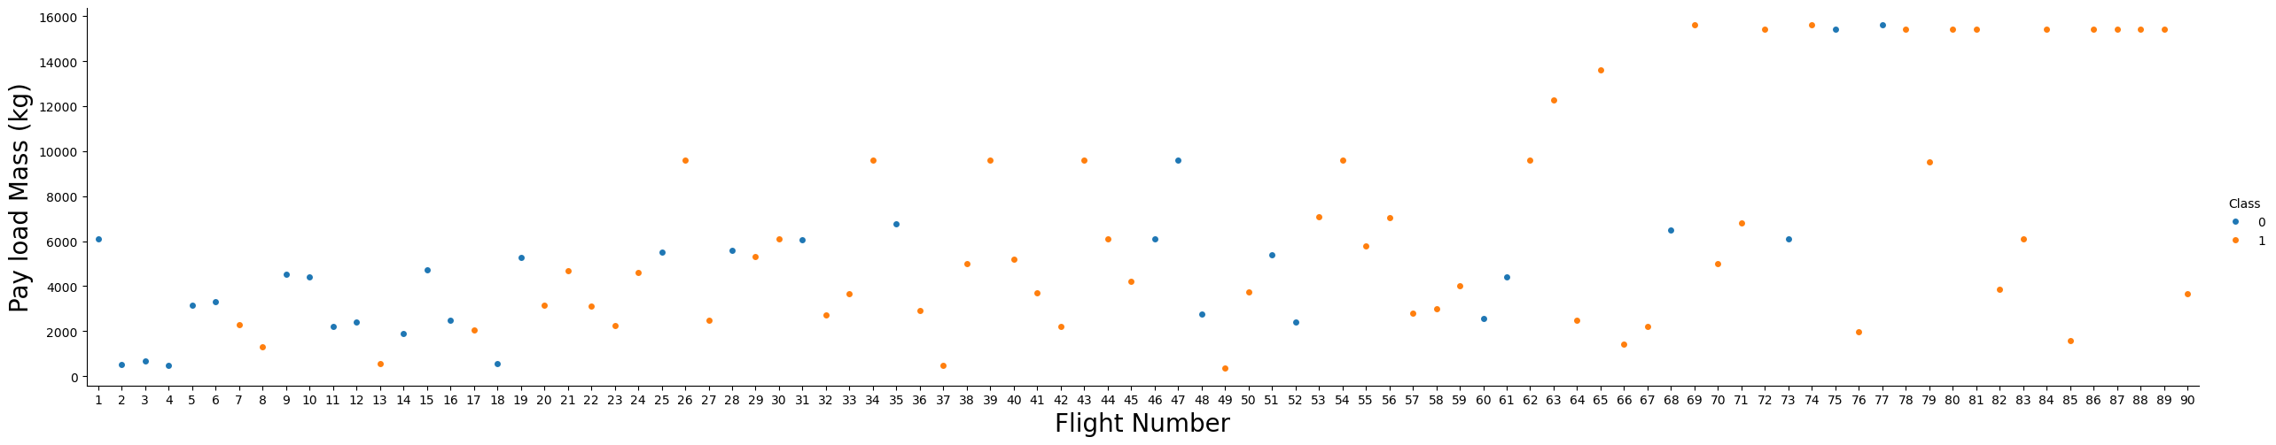
Flight Number vs. Launch Site
Flight Number vs. Launch Site
We see that as the flight number increases, the first stage is more likely to land successfully. The payload mass is also important; it seems the more massive the payload, the less likely the first stage will return.

Slide 19
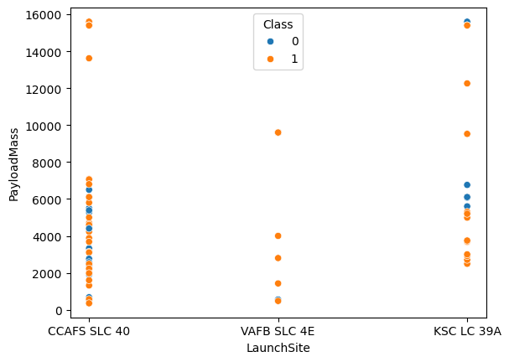
Payload vs. Launch Site
This plot highlights that for the VAFB-SLC launchsite there are no rockets launched for heavypayload mass(greater than 10000).
Payload vs. Launch Site

Slide 20
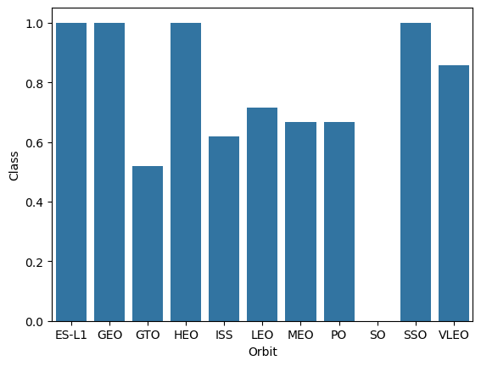
Success Rate vs. Orbit Type
The bar chat shows that ES-L1, GEO, HEO and SSO orbits have the highest success rate.
Success rate of each orbit type

Slide 21
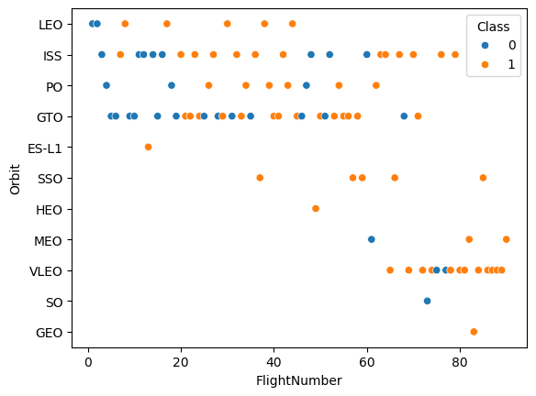
Flight Number vs. Orbit Type
We should observe that in the LEO orbit the Success appears related to the number of flights; on the other hand, there seems to be no relationship between flight number when in GTO orbit.
Flight number vs. Orbit type

Slide 22
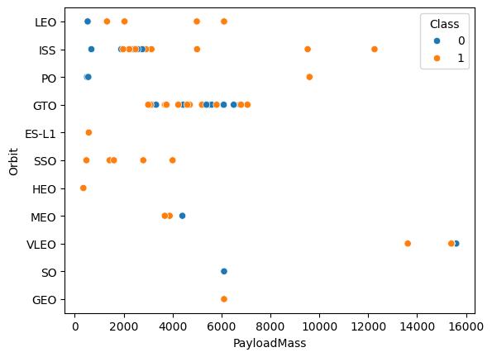
Payload vs. Orbit Type
With heavy payloads the successful landing or positive landing rate are more for Polar, LEO and ISS.
However for GTO we cannot distinguish this well as both positive landing rate and negative landing (unsuccessful mission) are both there.
Payload vs. orbit type

Slide 23
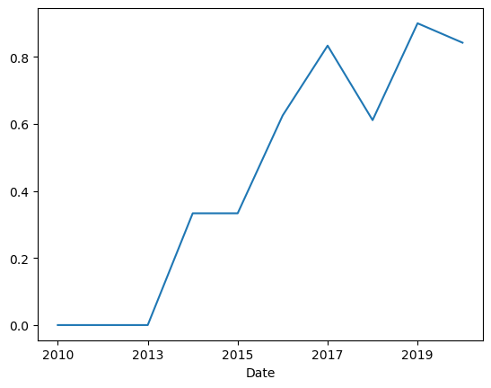
Launch Success Yearly Trend
The success rate since 2013 kept increasing till 2020 after a sharp fall around 2018.
Yearly average success rate

Slide 24
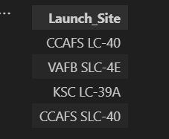
All Launch Site Names
Names of the unique launch sites
Falcon 9 rockets has been being launched on for sites.

Slide 25
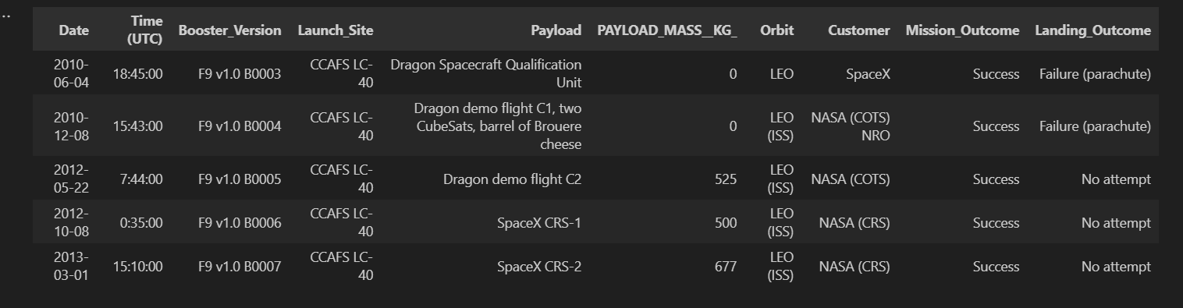
Launch Site Names Begin with 'CCA'
Five records where launch sites begin with `CCA`

Slide 26

Total Payload Mass
Total payload carried by boosters from NASA
NASA's boosters carried 45 596 Kg of payload in total

Slide 27
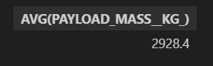
Average Payload Mass by F9 v1.1
Average payload mass carried by booster version F9 v1.1
Booster version F9 v1.1 carried in average 2 928.4 Kg of payload

Slide 28

First Successful Ground Landing Date
Date of the first successful landing outcome on ground pad
The first successful landing outcome on ground pad took place in December 22nd, 2015

Slide 29
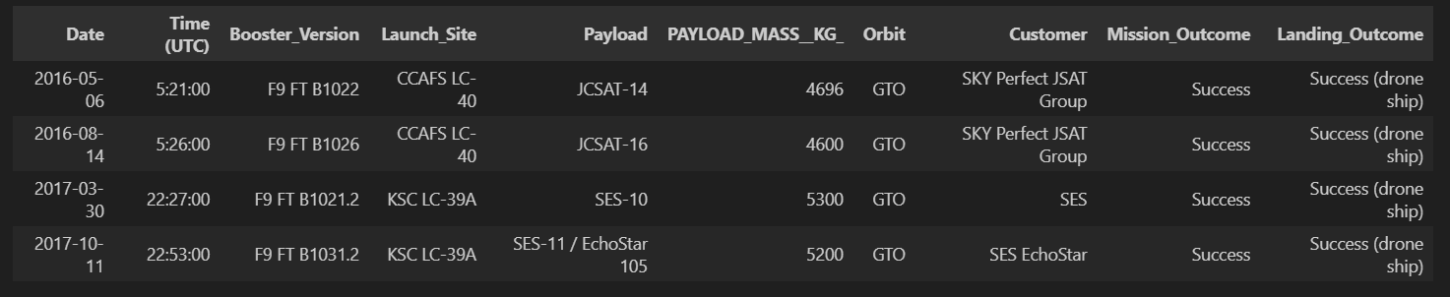
Successful Drone Ship Landing with Payload between 4000 and 6000
Boosters which have successfully landed on drone ship and had payload mass greater than 4000 but less than 6000
Four boosters have successfully landed on drone ship and had payload mass greater than 4000 but less than 6000​

Slide 30
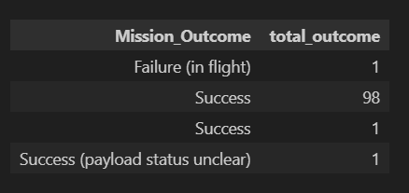
Total Number of Successful and Failure Mission Outcomes
Total number of successful and failure mission outcomes
SpaceX carried out 100 successful missions and 1 failure one

Slide 31
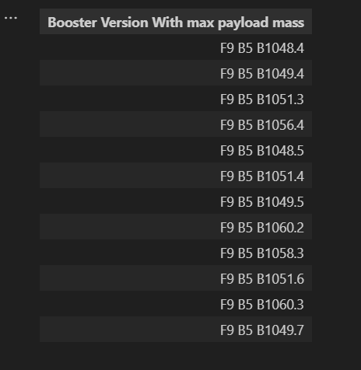
Boosters Carried Maximum Payload
12 booster have carried the maximum payload mass
Names of the booster which have carried the maximum payload mass

Slide 32
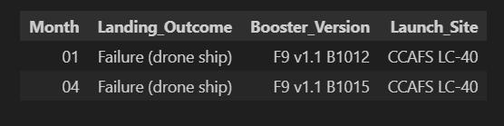
2015 Launch Records
List of failed landing outcomes in drone ship, with booster versions, and launch site names in year 2015

Slide 33
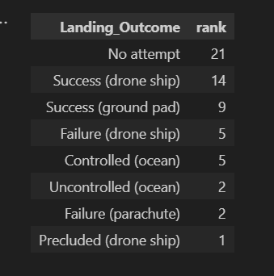
Rank Landing Outcomes Between 2010-06-04 and 2017-03-20
Ranking of the count of landing outcomes between the date 2010-06-04 and 2017-03-20
Apart of no attempts, success in drone ship landing is occurent

Slide 34

Section 3

Slide 35
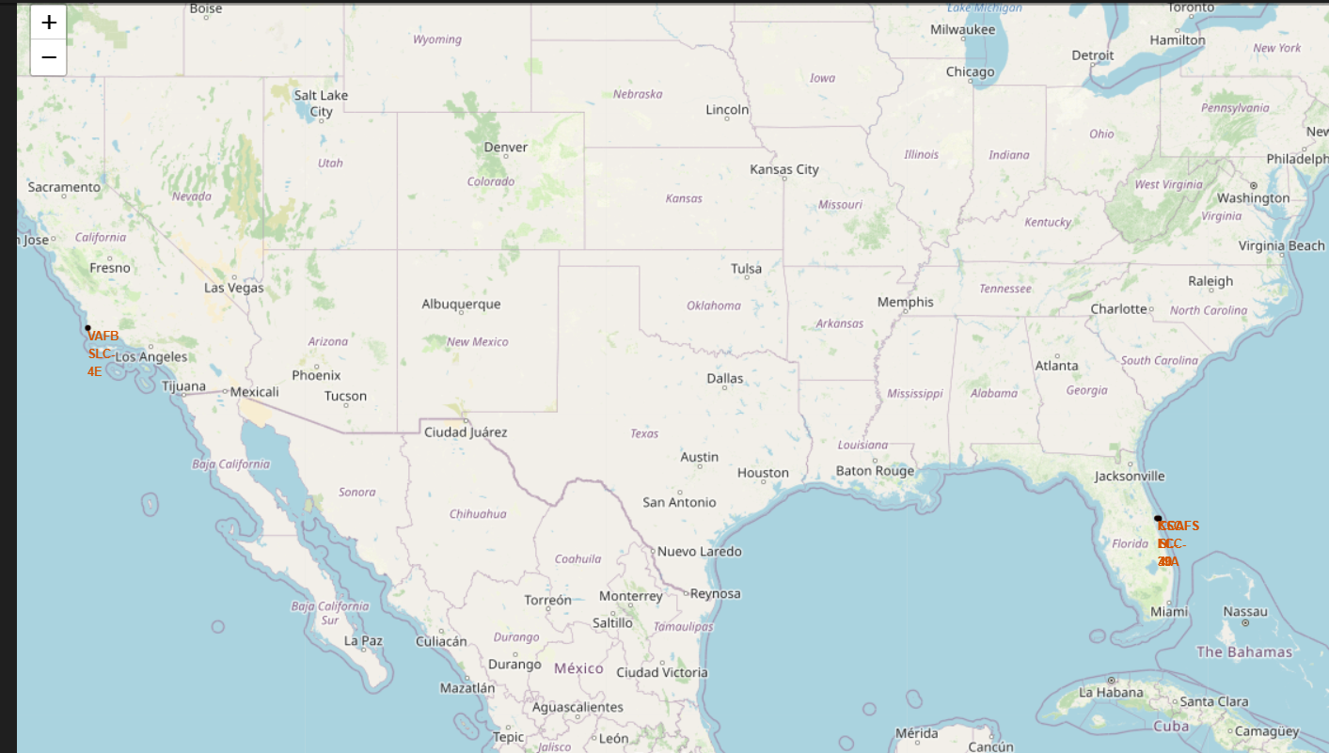
Launch sites locations
The above map points out that all launch sites are located near a coastline.

Slide 36
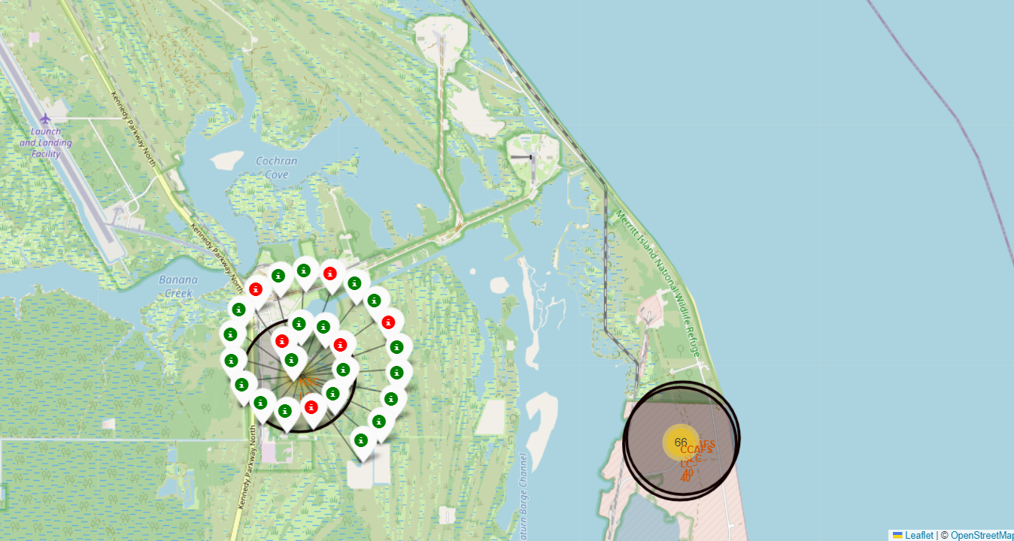
Successful and failure launches by site
The above map shows that for KSC LC-39A site, with 26 launches, most are successful (in green)

Slide 37
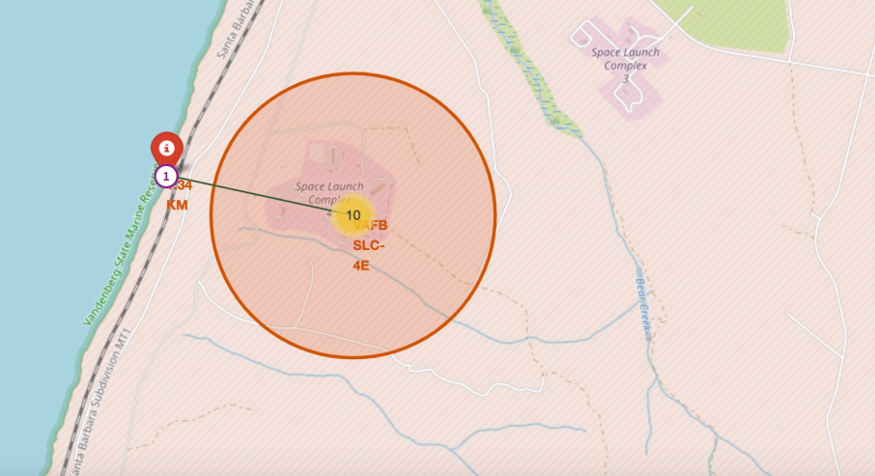
Sites proximity to coastlines
The above map shows that VAFB SLC-4E launch site is 1.34 Km far from a coastline

Slide 38

Section 4

Slide 39
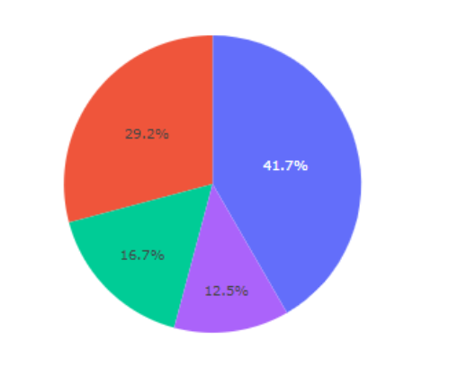
Total success launches by site
The pie chart shows the successful launches by site with 41.7% the highest ratio

Slide 40
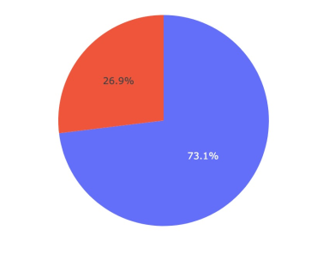
Launches outcome for a specific site
The pie chart shows the success launch ratio for the CCAFS LC-40 site. It is 73.1%

Slide 41
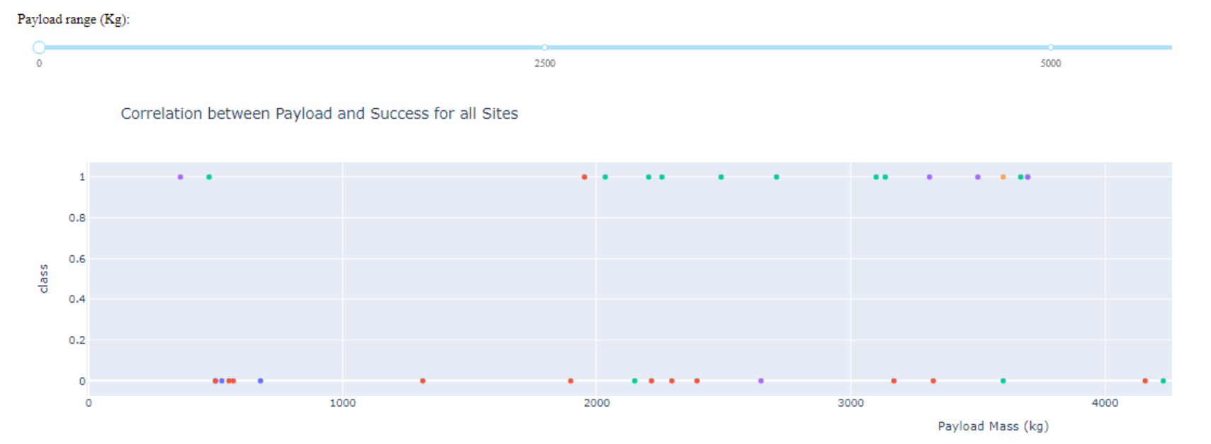
Correlation between payload and launch outcome
The chart shows correlation between payload and launch outcome for all sites. As the payload increases, CCAFS LC-40 site (in green) gives more successful launches

Slide 42

Section 5

Slide 43
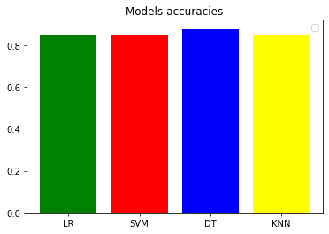
Classification Accuracy
The above chart shows the built model accuracy for all built classification models. The decision tree model comes out with the highest accuracy (0.8767).

Slide 44
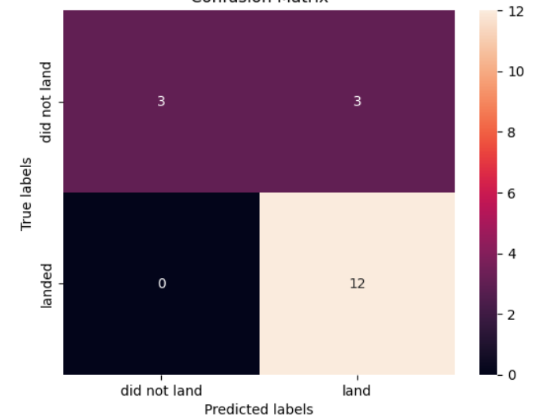
Confusion Matrix
The chart represents the confusion matrix of the decision tree classifier. The model predicts 3 landing as been successful while they were not (False Positive); this is the only drawback

Slide 45
Conclusions
The objective of this project was to predict the successful landing of the Falcon 9 first stage, a critical factor in SpaceX's cost-effective launch operations.
Each feature of the Falcon 9 launch, such as the payload mass, the launch site or the orbit type, may affect the mission outcome.
We collected comprehensive datasets exclusively from the SpaceX API and wikipedia, which provided detailed information on launch parameters such as launch dates, payload mass, launch sites, booster versions, and landing outcomes...
During the exploratory data analysis (EDA) phase, we examined the collected data to uncover patterns, trends, and relationships among the variables. We identified significant features influencing landing success, such as payload mass, launch site ...
We developed and tested several machine learning models to predict the successful landing of the Falcon 9 first stage. The models included logistic regression, support vector machine, decision tree, K nearest neighbor. They all came out with the same score and the same confusion matrix during the evaluation phase. We finally keep the best model as the one with the highest accuracy during the cross-validation : the decision tree.

Slide 46
Appendix
Find below some relevant assets for this project

Slide 47
Predictive Analysis (Classification)
Logistic regression
Tuned hyperparameters :(best parameters) {'C': 0.01, 'penalty': 'l2', 'solver': 'lbfgs'}
Accuracy (Cross validation best score) : 0.8464285714285713
Score : 0.833333333333334
Confusion matrix :

Slide 48
Predictive Analysis (Classification)
Support vector machine
Tuned hyperparameters : (best parameters) {'C': 1.0, 'gamma': 0.03162277660168379, 'kernel': 'sigmoid'}
Accuracy (Cross validation best score) : 0.8482142857142856
Score : 0.833333333333334
Confusion matrix :

Slide 49
Predictive Analysis (Classification)
Decision tree classifier
Tuned hyperparameters : (best parameters) {'criterion': 'entropy', 'max_depth': 4, 'max_features': 'sqrt', 'min_samples_leaf': 1, 'min_samples_split': 5, 'splitter': 'best'}
Accuracy (Cross validation best score) : 0.8767857142857143
Score : 0.833333333333334
Confusion matrix :

Slide 50
Predictive Analysis (Classification)
K Nearest Neighbors classifier
Tuned hyperparameters : (best parameters) {'algorithm': 'auto', 'n_neighbors': 10, 'p': 1}
Accuracy (Cross validation best score) : 0.8482142857142858
Score : 0.833333333333334
Confusion matrix :

Slide 51


